Slide 1
FINAL PROJECT AIRBNb PRICE IN EURO
Triandono Sutanto
Data science 17 | dibimbing.id

Slide 2

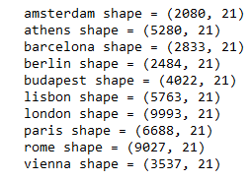
Know DATASET
Triandono Sutanto | Data Science 17
Dataset has contains
51,756 row
21 coloums
Its has coloums :
'realSum', 'room_type', 'room_shared', 'room_private',
'person_capacity', 'host_is_superhost', 'multi', 'biz',
'cleanliness_rating', 'guest_satisfaction_overall’,
'bedrooms', 'dist',
'metro_dist', 'attr_index', 'attr_index_norm', 'rest_index',
'rest_index_norm', 'lng', 'lat'
Dataset link ☺

Slide 3


WORKFLOW
Triandono Sutanto | Data Science 17
Weekend and Weekday dataset merge
Clean data
One hot n Freq encoding
Predict
Recomendation

Slide 4
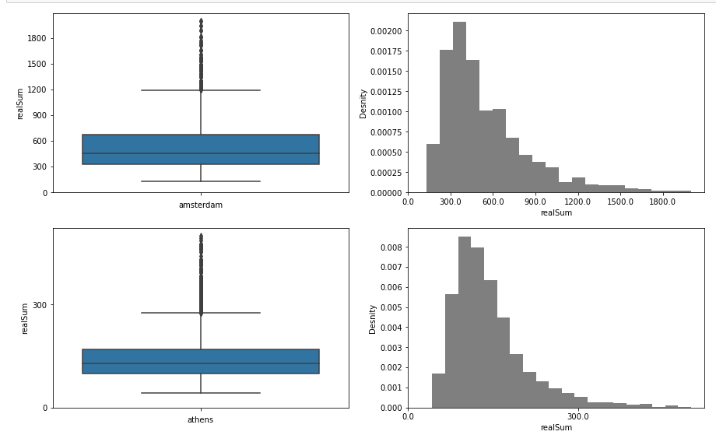
PREDICTIVE AIRBNB PRICE IN LONDON
Triandono Sutanto | Data Science 17
Know the situation

Slide 5
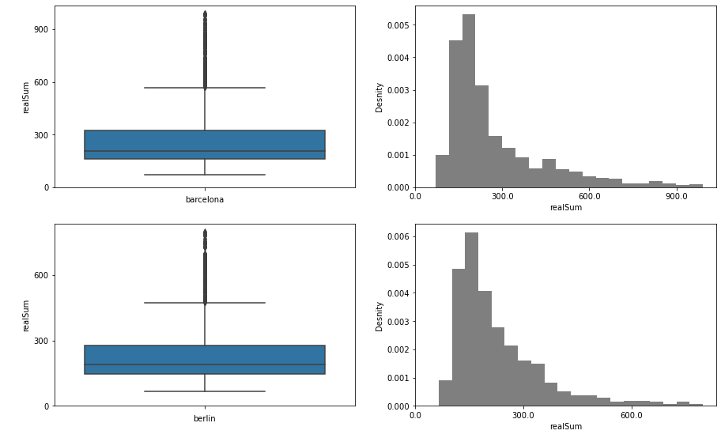
PREDICTIVE AIRBNB PRICE IN LONDON
Triandono Sutanto | Data Science 17
Know the situation

Slide 6
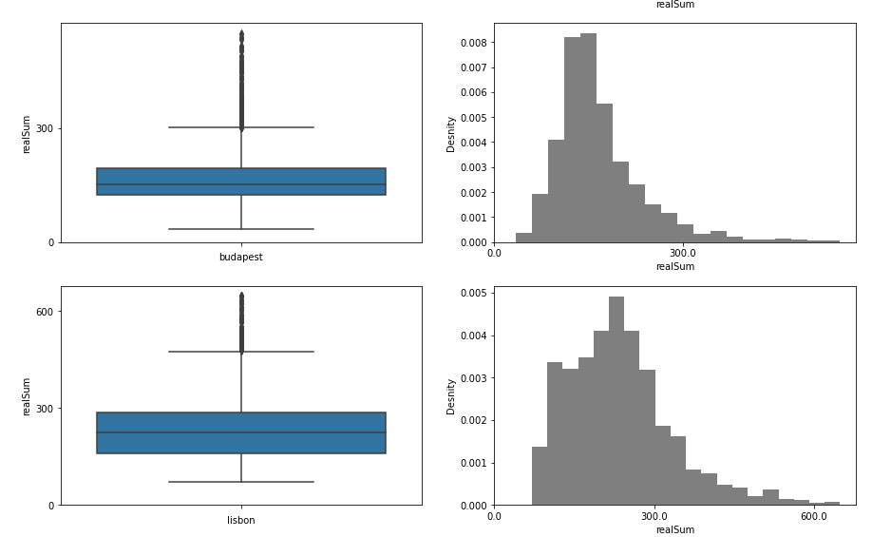
PREDICTIVE AIRBNB PRICE IN LONDON
Triandono Sutanto | Data Science 17
Know the situation

Slide 7
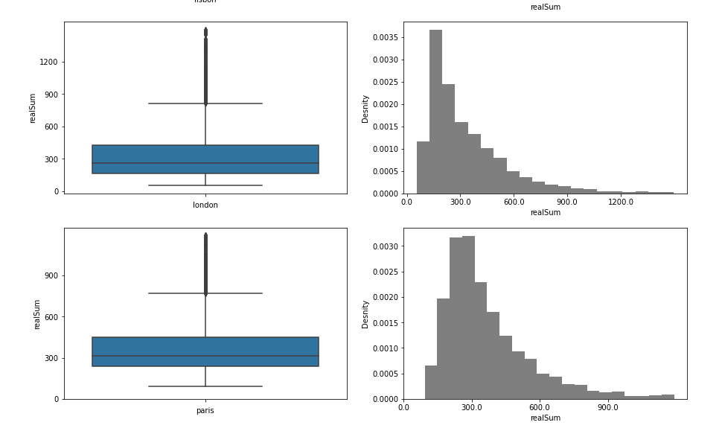
PREDICTIVE AIRBNB PRICE IN LONDON
Triandono Sutanto | Data Science 17
Know the situation

Slide 8
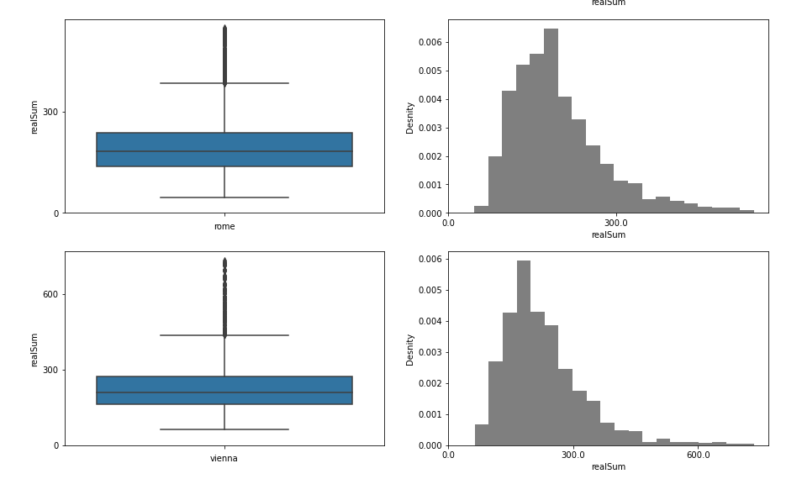
PREDICTIVE AIRBNB PRICE IN LONDON
Triandono Sutanto | Data Science 17
Know the situation

Slide 9
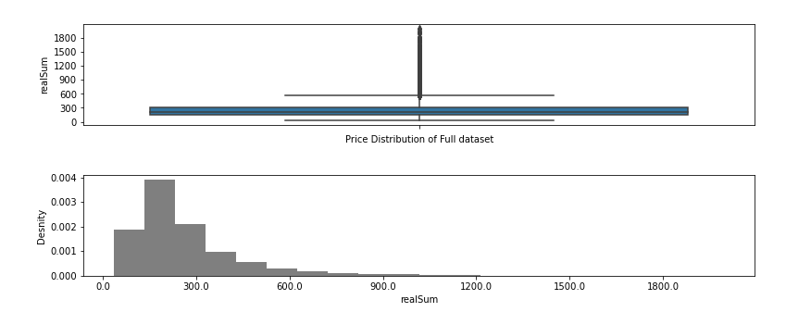
PREDICTIVE AIRBNB PRICE IN LONDON
Triandono Sutanto | Data Science 17
Know the situation

Slide 10
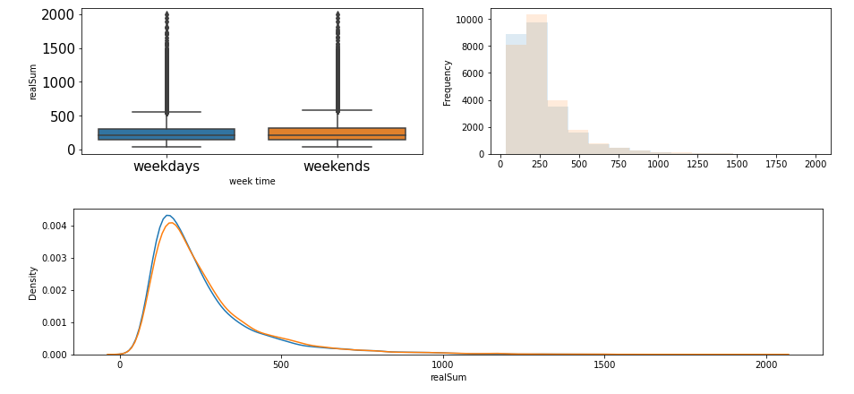
PREDICTIVE AIRBNB PRICE IN LONDON
Triandono Sutanto | Data Science 17
Weekday vs Weekends

Slide 11
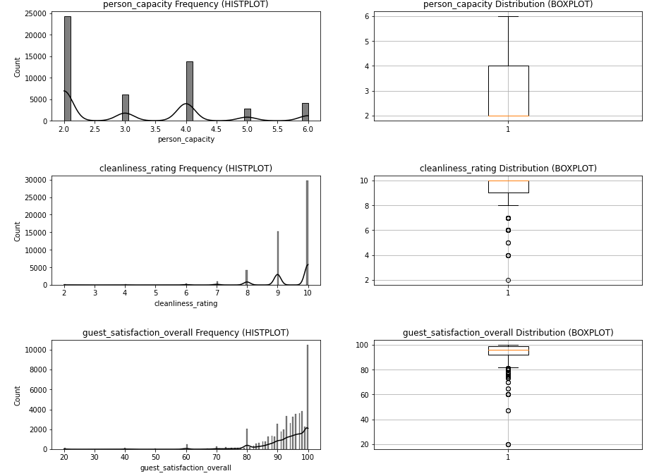
PREDICTIVE AIRBNB PRICE IN LONDON
Triandono Sutanto | Data Science 17

Slide 12
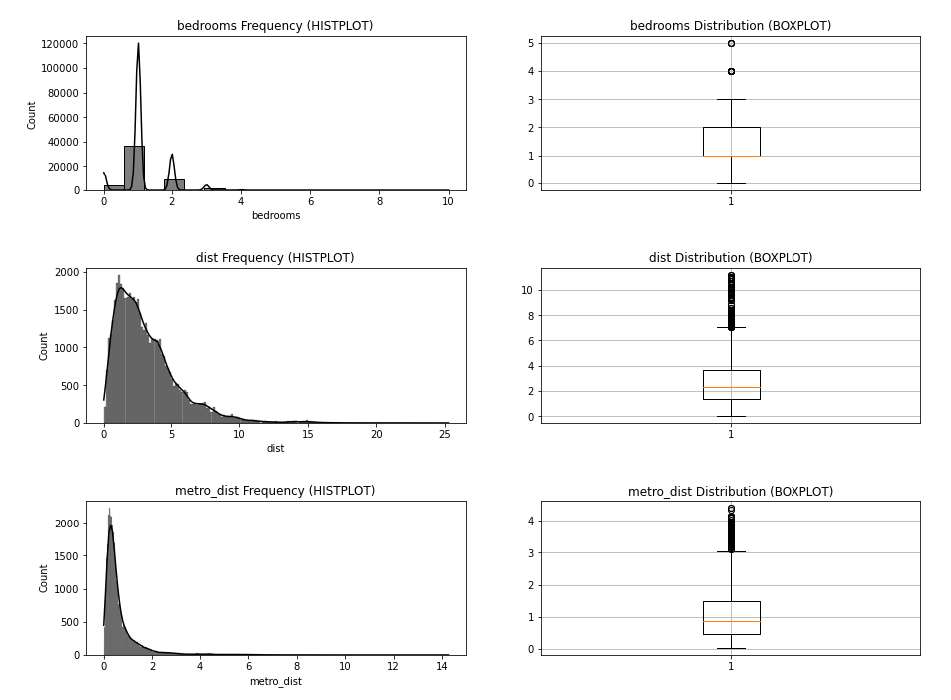
PREDICTIVE AIRBNB PRICE IN LONDON
Triandono Sutanto | Data Science 17

Slide 13
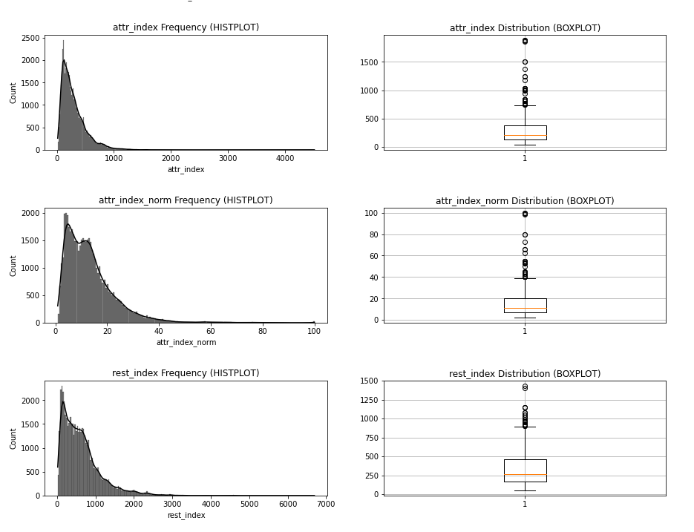
PREDICTIVE AIRBNB PRICE IN LONDON
Triandono Sutanto | Data Science 17

Slide 14
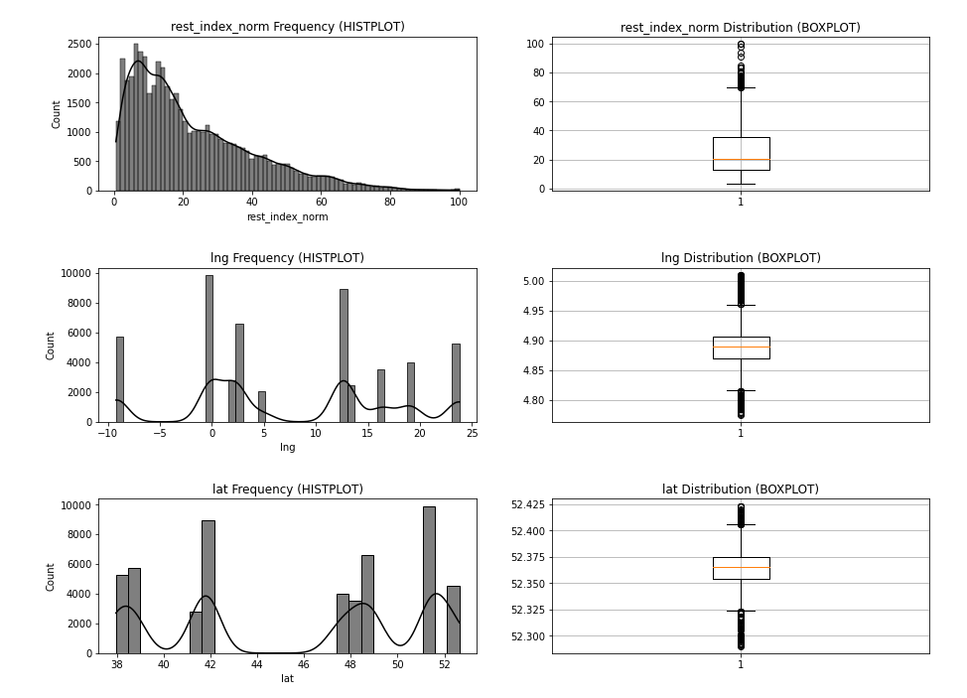
PREDICTIVE AIRBNB PRICE IN LONDON
Triandono Sutanto | Data Science 17

Slide 15
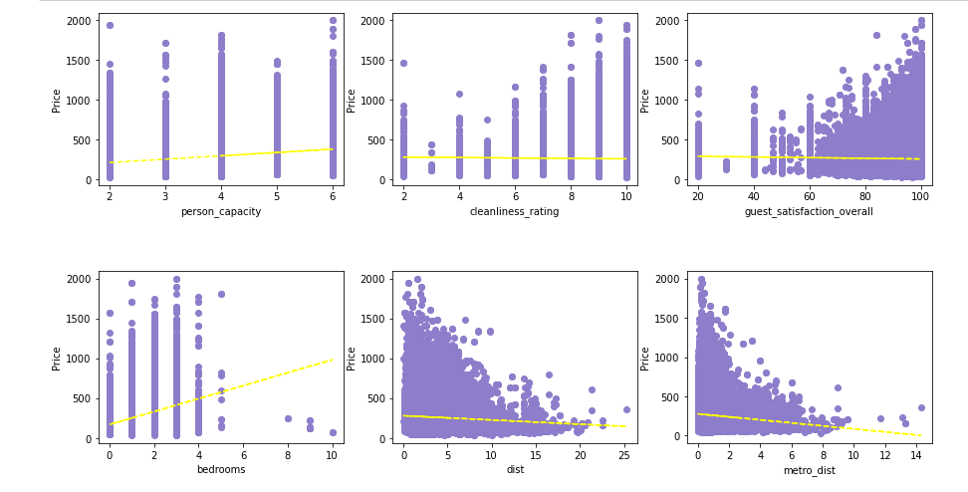
PREDICTIVE AIRBNB PRICE IN LONDON
Triandono Sutanto | Data Science 17

Slide 16
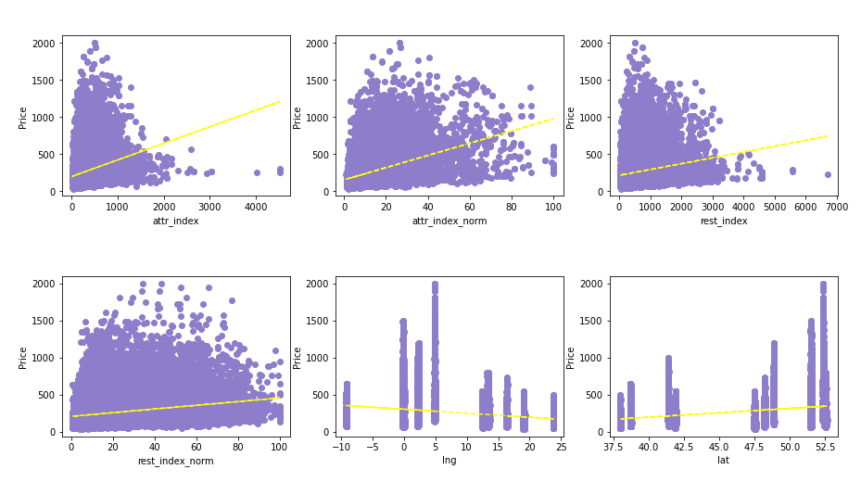
PREDICTIVE AIRBNB PRICE IN LONDON
Triandono Sutanto | Data Science 17

Slide 17
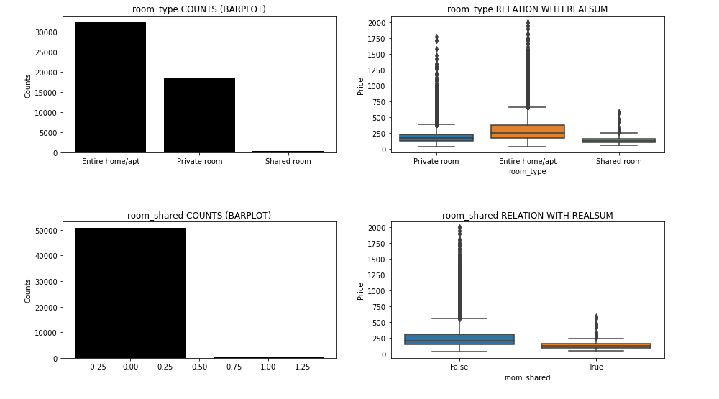
PREDICTIVE AIRBNB PRICE IN LONDON
Triandono Sutanto | Data Science 17

Slide 18
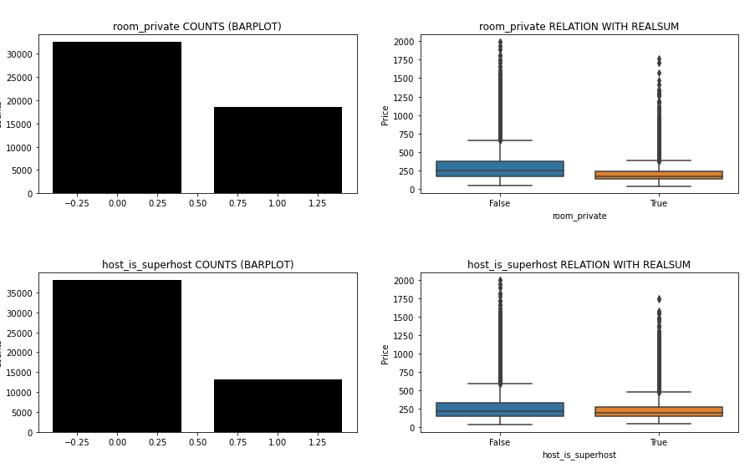
PREDICTIVE AIRBNB PRICE IN LONDON
Triandono Sutanto | Data Science 17

Slide 19
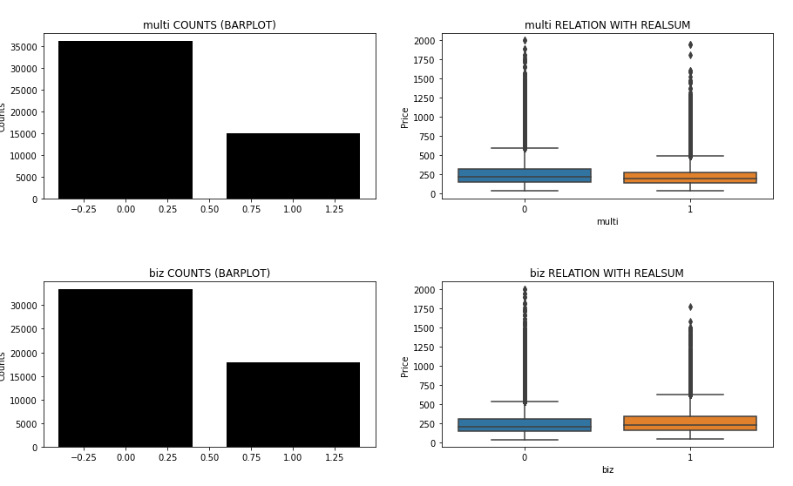
PREDICTIVE AIRBNB PRICE IN LONDON
Triandono Sutanto | Data Science 17

Slide 20
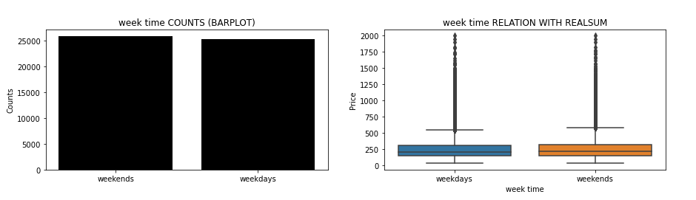
PREDICTIVE AIRBNB PRICE IN LONDON
Triandono Sutanto | Data Science 17

Slide 21
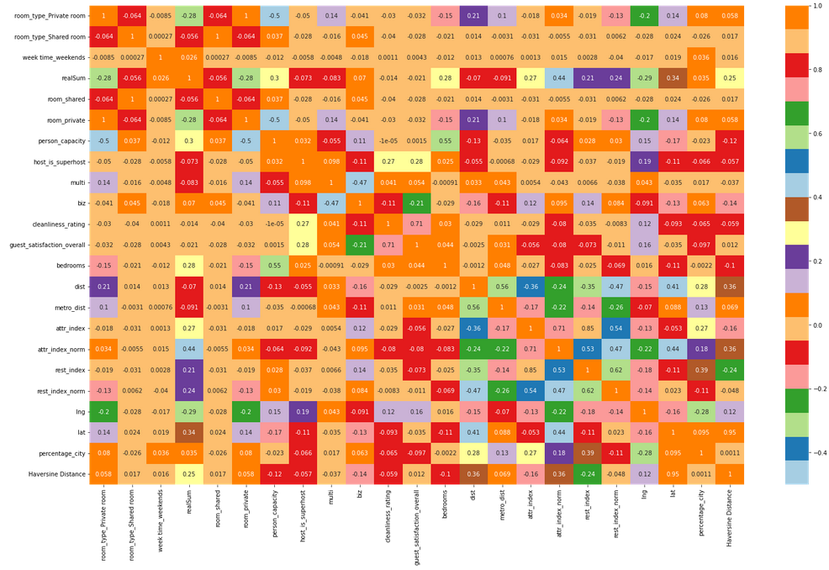
MULTICOLENARITY CHECK
Triandono Sutanto | Data Science 17

Slide 22
PREDICTIVE AIRBNB PRICE IN LONDON
Triandono Sutanto | Data Science 17
NO | MODEL | R-SQUARED |  | MAPE
 |  | TRAIN | TEST | TRAIN | TEST
1 | LINEAR REGRESION | 0.257 | 0.275 | 50.471 | 50.855
2 | RIDGE REGRESION | 0.257 | 0.275 | 50.471 | 50.855
3 | LASSO REGRESION | 0.252 | 0.269 | 50.679 | 50.928
4 | KNN (REGRESOR) | 0.63 | 0.45 | 29.467 | 36.931
5 | DECISION TREE | 1 | 0.738 | 6.492 | 17.324
6 | RANDOM FOREST | 0.976 | 0.842 | 6.38 | 17.031
7 | XGBOOST REGRESION | 0.833 | 0.7663 | 20.389 | 22.887

Slide 23
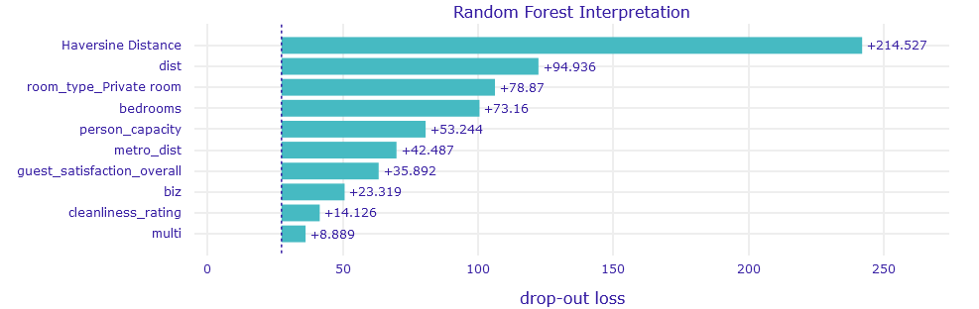
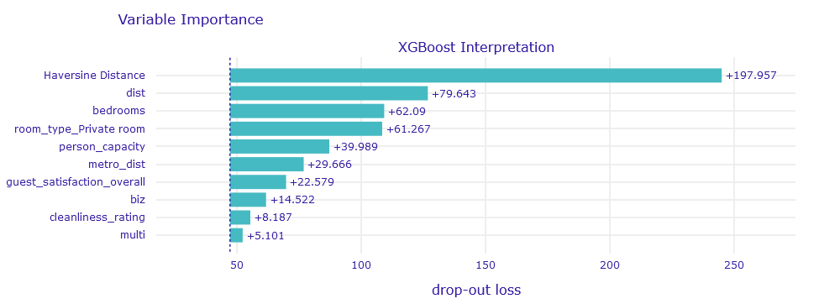
Triandono Sutanto | Data Science 17

Slide 24
CONCLUSION
Triandono Sutanto | Data Science 17
The farther away from city, the cheaper it will be
cleanliness factor does not effect the price
Biz class Airbnb does not effect the price
RECOMENDATION
The closer to the city the price becomes expensive.
the number of bedroom in the room will affect the price
if you want the price to go up, you have to make a private room

